Slide 1

ANALYTICS TOOLS FOR E-COMMERCE BUSINESS

Slide 2
ANALYTICS TOOLS FOR E-COMMERCE BUSINESS
TEAM MEMBERS
Sumasri Dandi
Srisairam Govindula
Shiva Sripelly
Keshav Ellaboina

Slide 3
OUTLINE
Introduction
Objective
IBM Cloud
IBM Cognos Analytics
Datasets

Slide 4
INTRODUCTION
With the increase in consumer demand, the E-commerce space has boomed. This also led to an increase in fierce competition in today's online marketplace.
The e-commerce industry sells a diverse product line of grocery items and merchandise products, such as food, pharmaceuticals, apparel, games and toys, hobby items, furniture, and appliances.
The analysis of such an industry is of great importance as it gives insights into the sales and profits of various products.

Slide 5
OBJECTIVE
With this analysis, the e-commerce business can identify various aspects of the shopping pattern and take measures if required.
The object of this challenge is to develop an Analytical Dashboard where the owner/user will understand the growth/potential of the business in the market.
BY THE END OF THIS PROJECT YOU WILL KNOW:
Know fundamental concepts and can work on IBM Cognos Analytics.
Gain a broad understanding of plotting different graphs.
Able to create dashboard.

Slide 6

IBM CLOUD
IBM cloud is a suite of cloud computing services from IBM that offers both platform as a service (paas) and infrastructure as a service (iaas). With IBM cloud iaas, organizations can deploy and access virtualized IT resources -- such as compute power, storage and networking -- over the internet.

Slide 7
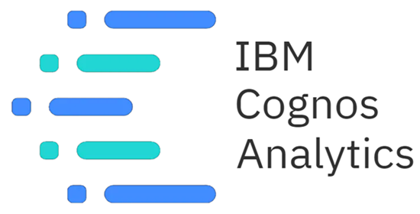
IBM COGNOS ANALYTICS
IBM cognos analytics is a set of business intelligence tools available on cloud or on-premise. The primary focus is in the area of descriptive analytics, to help users see the information in your data through dashboards, professional reporting and self-service data exploration.

Slide 8
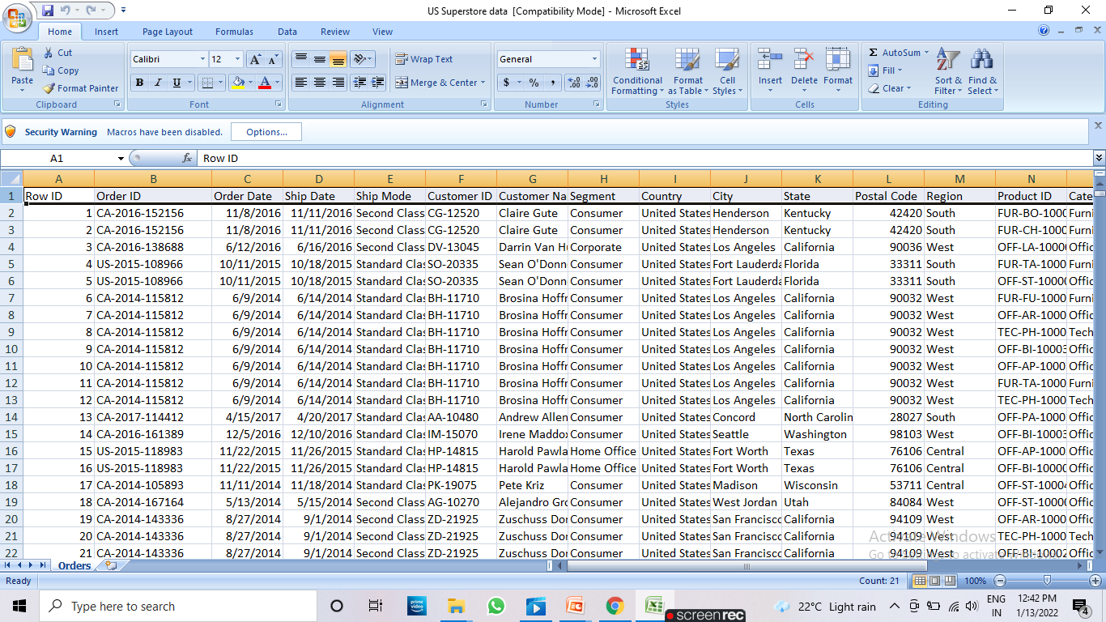
DATASETS
Analytics tools for e-commerce business contains one data set:
US Super Store Data.
The above given data set includes
Attributes like Order Id, Customer Id, Country, City, State, Region, Product, Category, etc.

Slide 9
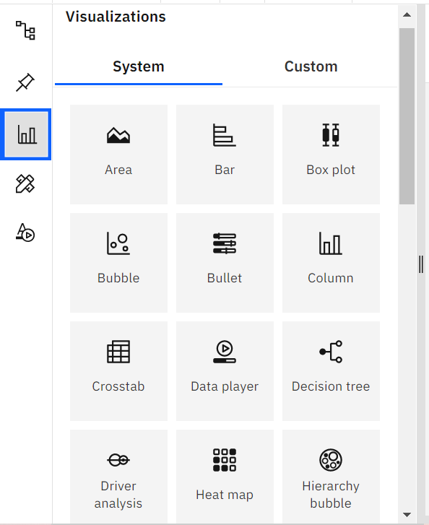
DATA VISUALIZATION
Data visualization is where a given dataset is presented in a graphical format.
It helps the detection of patterns, trends and correlations that might go and detected in test based data.
Using the e commerce dataset we plan to create various graphs and charts to high light the insights and visualizations.
To visualize the dataset we need ibm cognos analytics dashboard.
This dashboard contains different visualization charts such as bar, area, bubble, column, pie, etc charts.

Slide 10
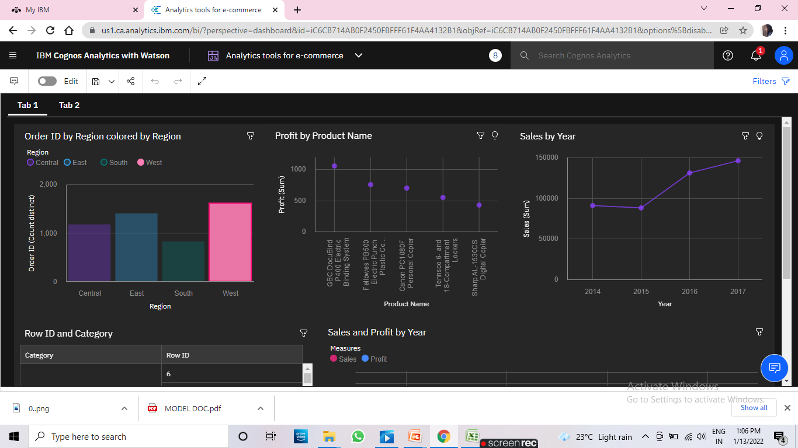
DATA VISUALIZATION CHARTS

Slide 11
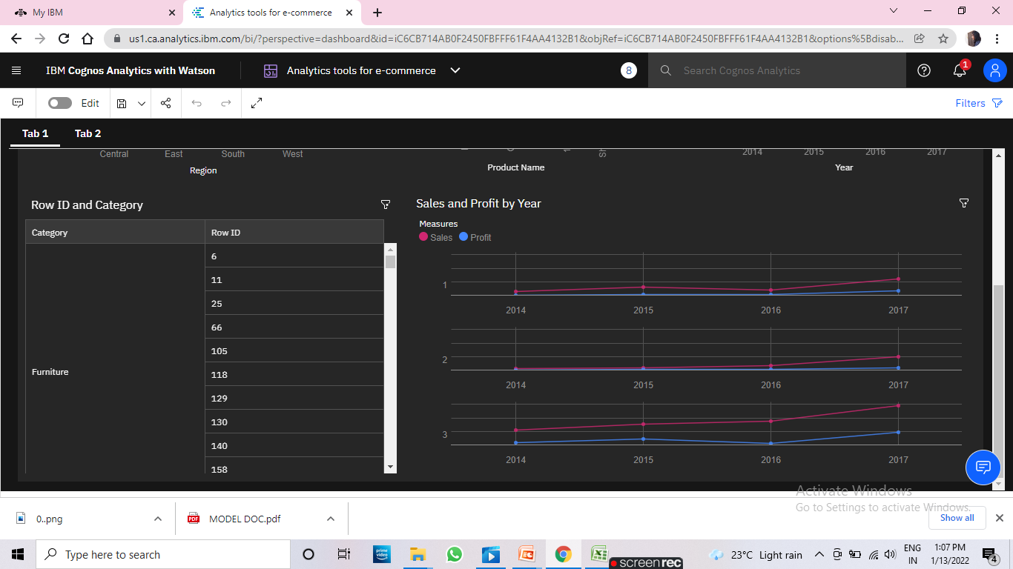

Slide 12
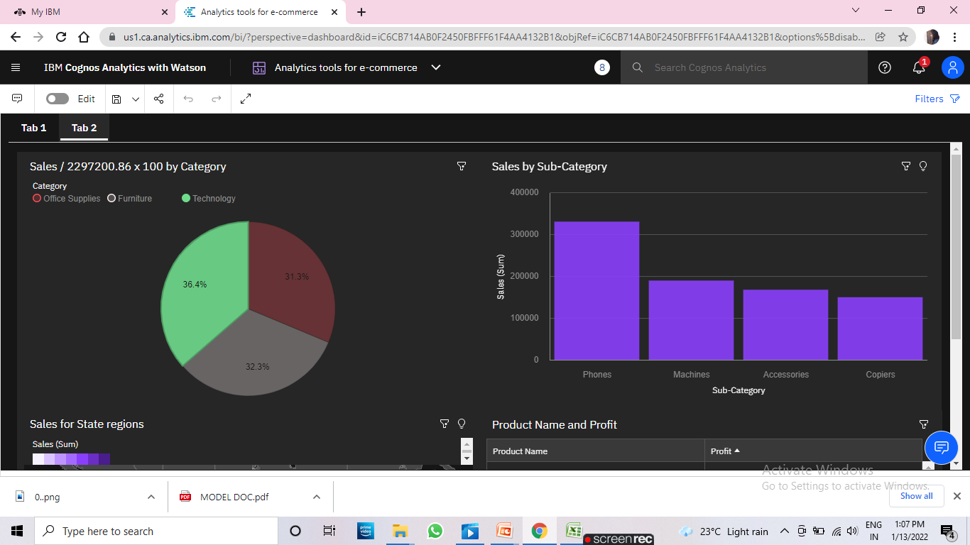

Slide 13
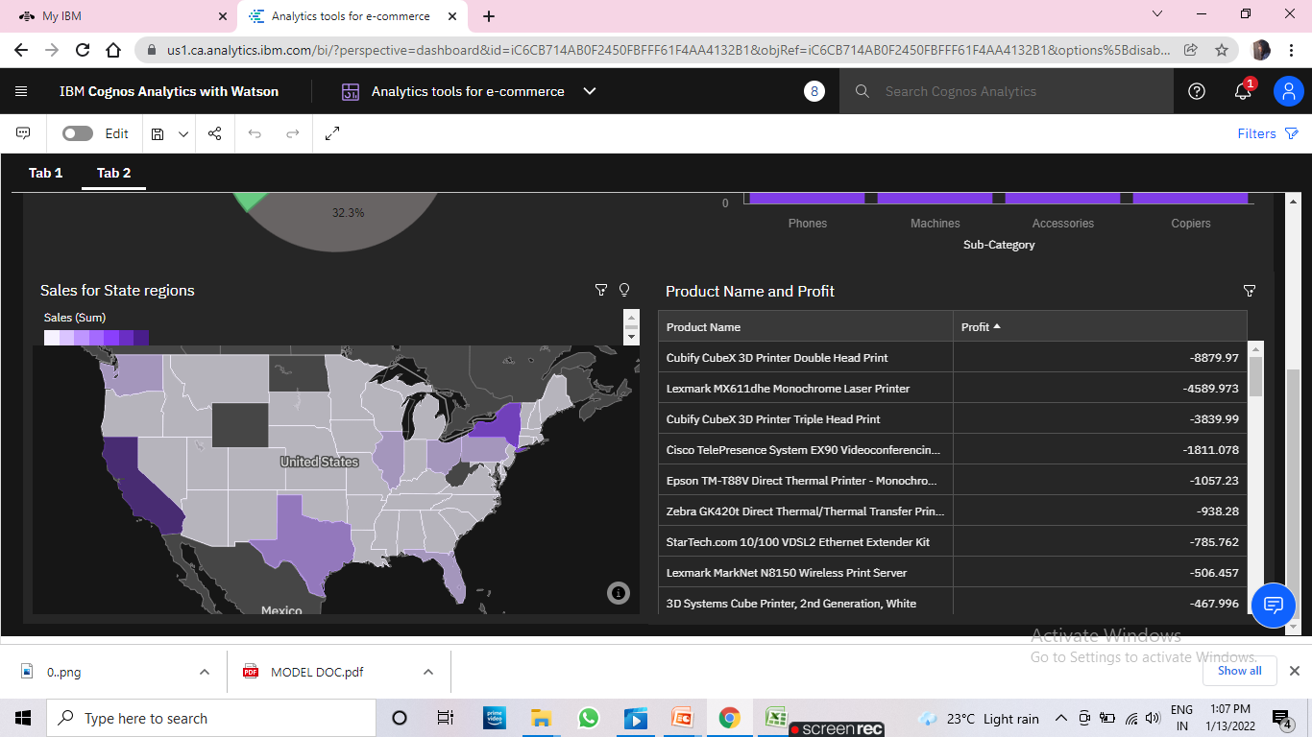

Slide 14
CONCLUSION
In this project we have presented that we will be analyzing some important visualizations, creating a dashboard and by going through these we will get most of the insights of E- commerce.
By the end of this project you will :
Know fundamental concepts and can work on IBM Cognos Analytics.
Gain a broad understanding of plotting different graphs.
Able to create meaningful dashboards.

Slide 15


